Slide 1
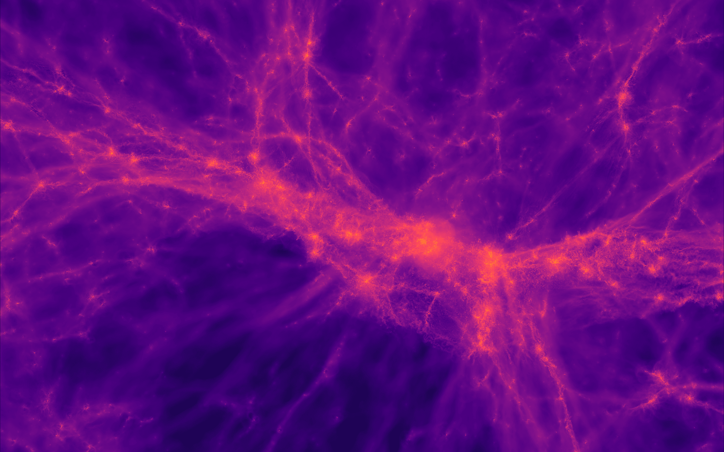
From detection of Galaxy Pairs to Dual Active Galactic Nuclei using Self-Supervised Active Learning Guided Detection System (SSALD)
Collaborators:
Diptarko Choudhury
Aniket Nath
Systematic search for Dual Active Galactic Nuclei is a serendipitous process.We aim to expedite the search process using Machine Learning. We will use the Sloan Digital Sky Survey (SDSS) dataset to implement our algorithm.

Slide 2
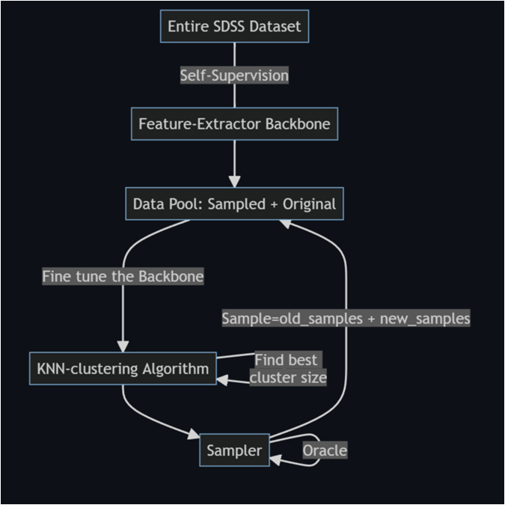
Training Algorithm and Plans
Base Line: We will start with literature survey and then we will train a self-supervised learning algorithm to understand the morphology of the given dataset without explicit label and then later finetune it for the downstream task of classification.
Midway targets: To get commendable classification performance from the feature extractor backbone and making sure that it is ready for the next stage.
Expected results: Once the backbone is ready, we will attach it with a active learning based algorithm to fine grain our classification performance and achieve state-of-the-art results.
Teammate with work division:
Aniket Nath: Explore different self-supervised algorithms, Fine tuning the backbone during active learning phase, labelling the samples during active learning phase.
Diptarko Choudhury: Explore different self-supervised algorithms, Fine tuning the sampler during active learning phase, labelling the samples during active learning phase.
Background Papers:
Automated Detection of Double Nuclei Galaxies using GOTHIC and the Discovery of a Large Sample of Dual AGN, Bhattacharya et. al.
Reducing Label Effort: Self-Supervised meets Active Learning, Bengar at. Al.
More papers to come…

